Slide 1
Cleaner Trucks Initiative Federal/State Technical Collaboration Group Call
March 15, 2019

Slide 2
Overview
Motivation
Background
Preliminary Rulemaking Timeline
Points of Contact

Slide 3
Motivation
EPA last revised NOx standards for heavy-duty (HD) trucks nearly 20 years ago
We have an opportunity to modernize the requirements to better reflect the capability of available emissions control technologies
Our current emissions performance standards have lowered overall NOx emissions, but have not encouraged effective emission control under low-load conditions (when at idle, moving slowly, or in stop-and-go traffic)
By addressing low-load operation, we can improve NOx emission controls in cities and in areas of high traffic, where it will make a big difference to communities

Slide 4
Impact of NOx Emissions from Heavy-Duty Diesel Vehicles
Highway Heavy-Duty Diesel Vehicles
Largest single contributor to mobile source NOx
One of the largest mobile source contributors to ozone in 2025
Significant mobile source contributor to PM_{2.5} in 2025, due to
NOx emissions which form PM
Directly emitted PM
Many HD vehicles travel interstate, and areas impacted most by NOx emissions are distributed around the country
June 2016: South Coast AQMD along with 20 other state and local government agencies petitioned EPA to reduce the federal highway heavy-duty engine NOx standards

Slide 5
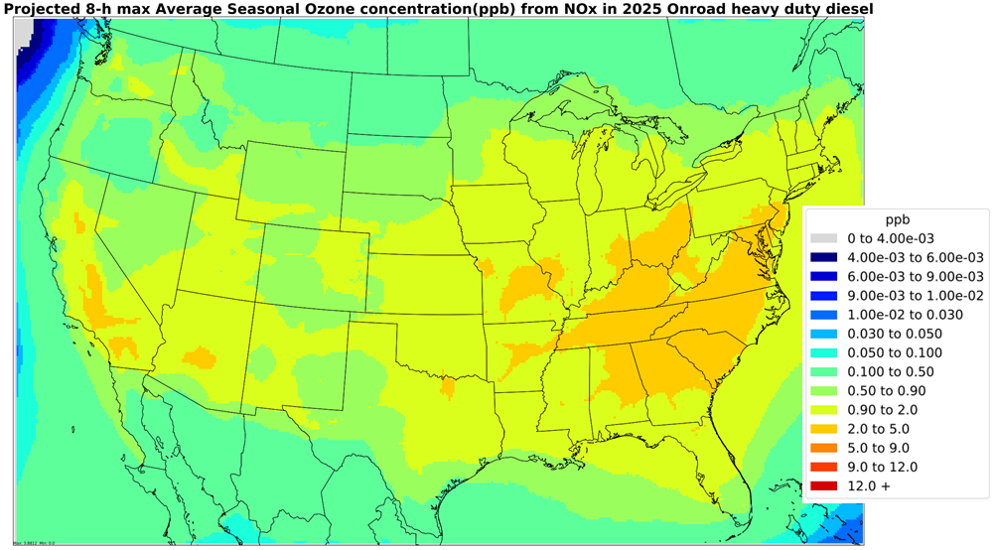
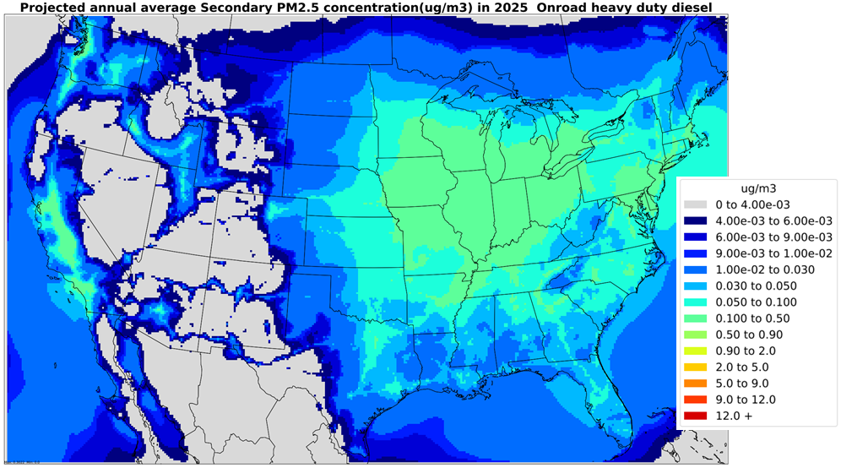
Impact of NOx Emissions from Heavy-Duty Diesel Vehicles*
NO_{x} Contribution to Ozone in 2025
NO_{x} Contribution to Ambient PM_{2.5} in 2025
* Zawacki, et al. https://doi.org/10.1016/j.atmosenv.2018.04.057

Slide 6
The Cleaner Trucks Initiative
On November 13, 2018, EPA Acting Administrator Andrew Wheeler announced the “Cleaner Trucks Initiative” (CTI) to address emissions from new heavy-duty trucks and engines
Our objective is to achieve lower NOx emissions nationwide
Ensure real world emissions reductions
Investigate options for pre-production certification and in-use testing
Pursue a national, harmonized program
California already working on a low NOx program
Focus on NOx, and take a broad look at other heavy-duty engine emissions
Additionally, we want to identify cost-effective means of assuring real-world compliance, and explore opportunities to streamline existing requirements

Slide 7
CTI Rulemaking Timeframe and Current Status
Targeting 2020 for a notice of proposed rulemaking (NPRM)
Comment period after the proposal, followed by final rulemaking (FRM)
Currently in the information-gathering stage
Early outreach to stakeholders
OEMs, Suppliers, States, Tribes, Labor, Fleets/OO, Env. NGOs, Dealerships
Continuing engagement with California Air Resources Board (CARB)
Coordinate our technical work with CARB staff
Preparing small business outreach
Assessing technical feasibility
Cost and effectiveness of advanced technologies and compliance strategies
Planning cost, benefit, inventory, air quality, and economic analyses

Slide 8
Points of Contact
Director, ASD’s Heavy-Duty Onroad & Nonroad Center
Brian Nelson, Nelson.Brian@epa.gov, 734-214-4278
CTI Rulemaking Team Leads
James Sanchez, Sanchez.James@epa.gov,734-214-4439
Jessica Brakora, Brakora.Jessica@epa.gov, 734-214-4936
Christy Parsons, Parsons.Christy@epa.gov, 734-214-4243

